Slide 1
Software Design for Cloud 2
Python Programming
Lecture 2
Decisions & Loops

Slide 2
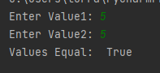
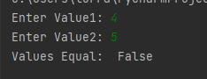
Boolean Types and if statement
def main():
res = False
val1 = int(input('Enter Value1: '))
val2 = int(input('Enter Value2: '))
if (val1==val2):
res=True
print('Values Equal: ', res)
main()

Slide 3
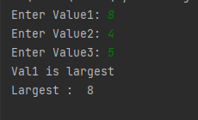
if statement
def main():
val1 = int(input('Enter Value1: '))
val2 = int(input('Enter Value2: '))
val3 = int(input('Enter Value3: '))
if (val1>val2 and (val1>val3)):
res=val1
print('Val1 is largest')
else:
res=0
print('Val1 is not largest')
print('Largest : ', res)
main()
Operators:
>, <, >=, <=, ==, !=
and or not

Slide 4
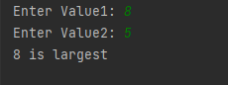
Ex21
Enter two integers and print out the Larger
if (cond1): stmt1 else: stmt2

Slide 5
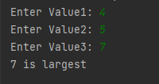
Ex22
Enter three integers and print out the Largest
if (cond1): stmt1 else: if (cond2): stmt2 else:
stmt3

Slide 6
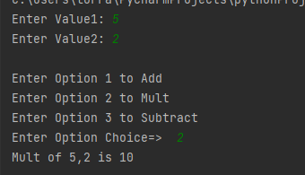
Ex23: Alternative elif:
Enter 2 values and give user options to add, mult or subtract as shown. Use elif
Use: print('Sum of {0},{1} is {2)'.format(val1, val2, result))
if (cond1): stmt1 elif (cond2): stmt2 else:
stmt3
Enter two integers and option 1, 2 or 3
if (cond1): stmt1 elif (cond2): stmt2 else:
stmt3

Slide 7
Iteration

Slide 8
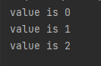
While loop
while(cond1): stmt1
stmt2
def main():
count=0 # step 1
while (count <3): # step 2
print('value is {0}'.format(count))
count= count + 1 # step 3
main()

Slide 9
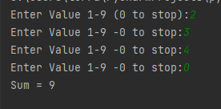
While loop
def main():
value=int(input('Enter Value 1-9 (0 to stop):'))
total=0
while value!=0: # step 2
total = total + value
value = int(input('Enter Value 1-9 -0 to stop:'))
print('Sum = {0}'.format(total))
main()

Slide 10
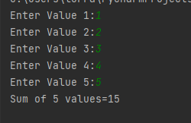
Ex24: While loop
Enter 5 integer values in a while loop and print out sum as shown. Use while

Slide 11
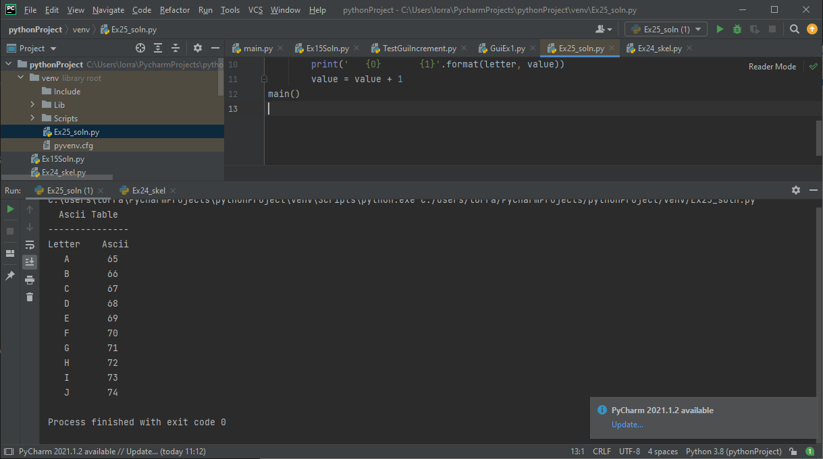
Ex25: Ascii Table
print out first 10 items in ascii table as shown (right).
Use while loop 65 to 74
print(' Ascii Table')
print('---------------')
print('Letter Ascii’)
value=65
letter = chr(value)
print(' {0} {1}'.format(letter, value))

Slide 12
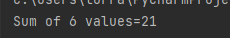
for in loop
print out values 1-6 inclusive
def main():
result=0
for value in [1,2,3,4,5,6]:
result = result + value
print('Sum of 6 values={0}'.format(result))
main()

Slide 13
for in loop
print out values 1-6 inclusive
def main():
result=0
for value in range(1,7):
result = result + value
print('sum of 6 values={0}'.format(result))
main()

Slide 14
Ascii Table
def main():
value=65
print(' Ascii Table')
print('---------------')
print('Letter Ascii')
for value in range (65,100):
letter = chr(value)
print(' {0} {1}'.format(letter, value))
value = value + 1
if (value==73): break
main()

Slide 15
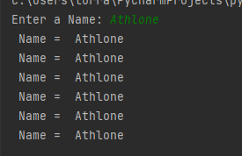
Ex26:
Enter Name & then print that name out 6
times using a for loop

Slide 16
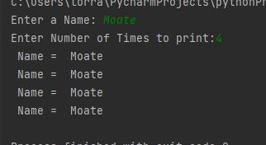
Ex27:
Enter Name & then enter number of times to print that name out times using a for loop

Slide 17
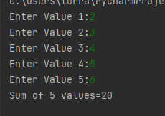
Ex28:
Read in and add 5 values using for(right).
Use for loop 0 to 5
def main():
count=0
result=0
while (count<5):
value = int(input('Enter Value {0}:'.format(count+1)))
result = result + value
count = count + 1
print('Sum of 5 values={0}'.format(result))
main()

